Slide 1
UNIT-3
Lecture 5

Slide 2
Distribution Analysis:
Distribution Analysis examines how values of a variable are spread across a dataset.
It helps to understand:
Shape of data distribution
Central tendency
Variability of data
Presence of skewness and outliers
Distribution analysis is an important step in Exploratory Data Analysis (EDA).

Slide 3
Why Distribution Analysis is Important:
Distribution analysis helps to:
Understand data patterns
Detect skewness in data
Identify outliers
Check normal distribution assumptions
Choose appropriate machine learning models

Slide 4
Types of Distribution Shapes:
Common distribution patterns include:
Normal Distribution: Symmetrical distribution
Mean = Median = Mode
Right Skewed Distribution: Tail extends toward right
Mean > Median
Left Skewed Distribution: Tail extends toward left
Mean < Median

Slide 5
Methods Used for Distribution Analysis:
Common visualization techniques:
Histogram
Density Plot (KDE): sns.kdeplot(data), sns.kdeplot(df["Salary"])
Box Plot
Violin Plot
Distribution Plot

Slide 6
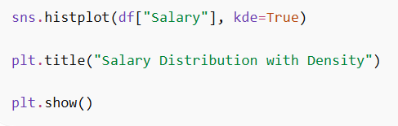


Distribution Plot:
A Distribution Plot combines:
Histogram
KDE curve
This gives both frequency and density information.

Slide 7
Skewness:
Skewness measures the asymmetry of a probability distribution around its mean.
It indicates whether data values are stretched more toward the left or the right side, affecting the distribution’s overall balance.
Helps understand the direction of extreme values.
Influences the difference between mean, median and mode.
Useful in identifying required transformations for modelling

Slide 8
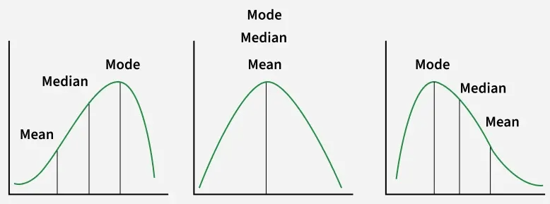

Slide 9
Kurtosis:
Kurtosis measures how sharp the peak of a distribution is and how heavy or light its tails are compared to a normal distribution.
It shows how much of the data lies close to the center and how much appears in the extreme ends.
Higher kurtosis implies more extreme outliers.
Lower kurtosis implies fewer extreme values and smoother tails.
Excess kurtosis (kurtosis − 3) is commonly used for interpretation.

Slide 10
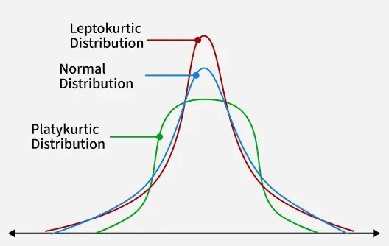
Types of Kurtosis:

Slide 11
Mesokurtic Distribution:
Kurtosis ≈ 3
Similar to normal distribution
Moderate tails
Example: Normally distributed data.

Slide 12
Leptokurtic Distribution:
Kurtosis > 3
Heavy tails
More outliers present
Characteristics:
Sharper peak
Higher probability of extreme values

Slide 13
Platykurtic Distribution:
Kurtosis < 3
Light tails
Fewer outliers
Characteristics:
Flatter peak
More evenly spread data

Slide 14
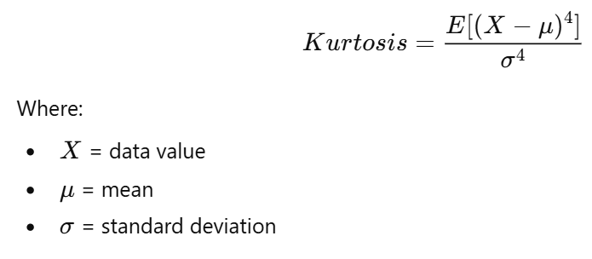


Slide 15
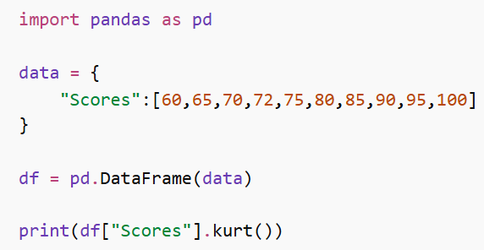

Slide 16
Detecting Patterns in Data:
A pattern refers to a regular relationship or structure within the data.
Pattern detection helps to:
Identify relationships between variables
Understand data behavior
Support predictive modeling
Example patterns:
Linear relationships
Seasonal patterns
Cyclical trends

Slide 17
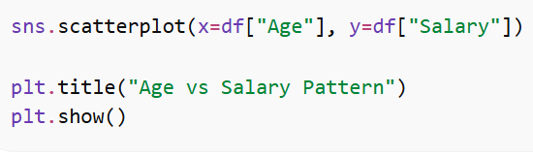
Detecting Patterns Using Visualization:
Scatter plots help identify patterns between variables.

Slide 18
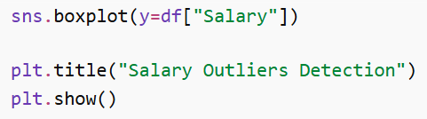

Detecting Anomalies (Outliers):
An anomaly or outlier is a data point that significantly differs from other observations.
Outliers may indicate:
Data errors
Rare events
Fraudulent activity
Important observations

Slide 19
Types of Anomalies:
1. Point Anomaly
A single data point that is very different from others.
Example: Daily temperature: 30, 31, 32, 60, 29
Here 60 is a point anomaly.

Slide 20
2. Contextual Anomaly
An observation that is abnormal in a specific context.
Example:
Temperature 30°C in summer → normal
Temperature 30°C in winter → anomaly
3. Collective Anomaly
A group of observations that together behave abnormally.
Example:
Network traffic suddenly spikes for several minutes.

Slide 21
Methods to Detect Anomalies
Statistical Methods
Z-score
IQR (Interquartile Range)

Slide 22
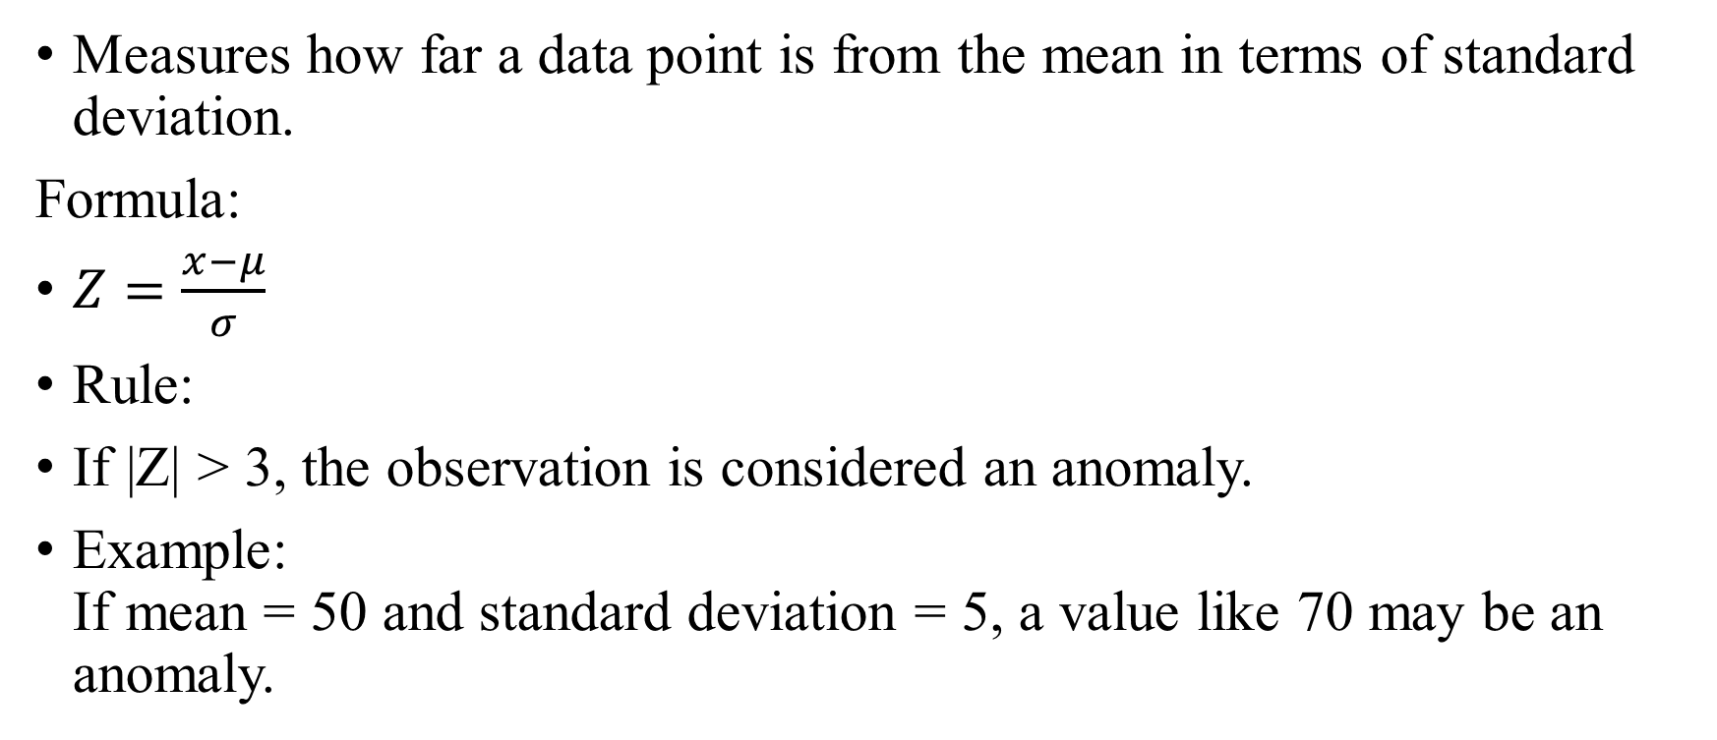
Z-Score Method:
Measures how far a data point is from the mean in terms of standard deviation.
Formula:
$Z=\frac{x−μ}{σ}$
Rule:
If |Z| > 3, the observation is considered an anomaly.
Example: If mean = 50 and standard deviation = 5, a value like 70 may be an anomaly.

Slide 23
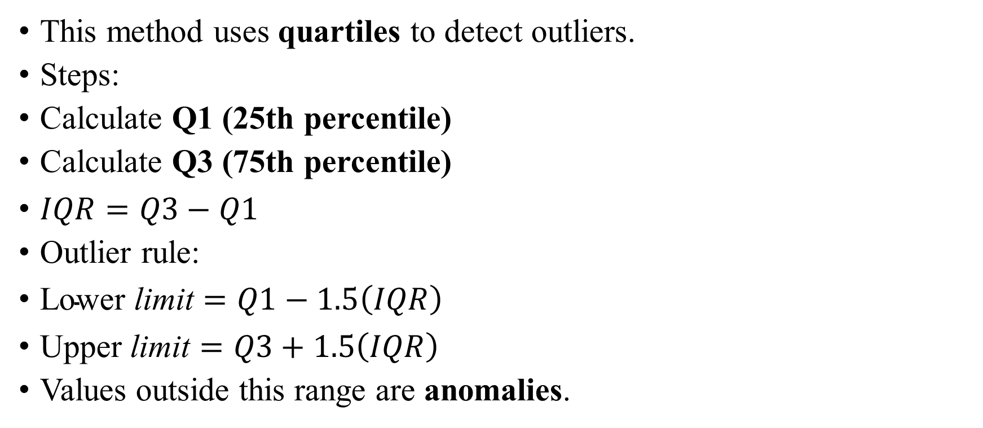
Interquartile Range (IQR) Method:
This method uses quartiles to detect outliers.
Steps:
Calculate Q1 (25th percentile)
Calculate Q3 (75th percentile)
$IQR=Q3−Q1$
Outlier rule:
$\text{Lower} \text{limit}=Q1−1.5\left(IQR\right)$
$\text{Upper} \text{limit}=Q3+1.5\left(IQR\right)$
Values outside this range are anomalies.

Slide 24
Detecting Trends:
A trend represents a long-term increase or decrease in data over time.
Common trends include:
Increasing trend
Decreasing trend
Seasonal trend
Trend detection is widely used in:
Sales forecasting
Stock market analysis
Climate studies

Slide 25
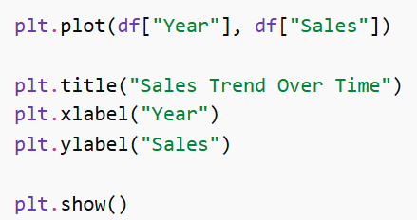

Slide 26
Integration with EDA Workflow:
Distribution analysis is an important step within the Exploratory Data Analysis (EDA) workflow.
Typical EDA workflow includes:
Data collection
Data cleaning
Data transformation
Distribution analysis
Relationship analysis
Feature selection
Data visualization

Slide 27
Role of Distribution Analysis in EDA:
Distribution analysis helps to:
Understand data structure
Detect skewness and kurtosis
Identify anomalies
Prepare data for machine learning models
It provides insights before building predictive models.

